Slide 2
Who we are
Teresa Carr Buckley
Before I became a full time carer, I was a social care worker in a former life. I worked in areas of disability, child protection and working with the homeless. I was also a volunteer with St. Vincent De Paul and I also hold a QQ I level 7 in autism studies from UCC.
I was a voluntary Director of a well-known Wexford Charity. My roles on the board was vice treasurer and company secretary. Mag Furness is the other co founders of the #dreambig project which will be Irelands first neurodiverse social enterprise. The enterprise will consist of a restaurant, art gallery, pottery usiness band a bakery. We have plans to set up a neurodivergent specific respite centre and pre school.
I'm also presently on the committee of the New Ross Rainbow youth club for children with additional needs.

Slide 3
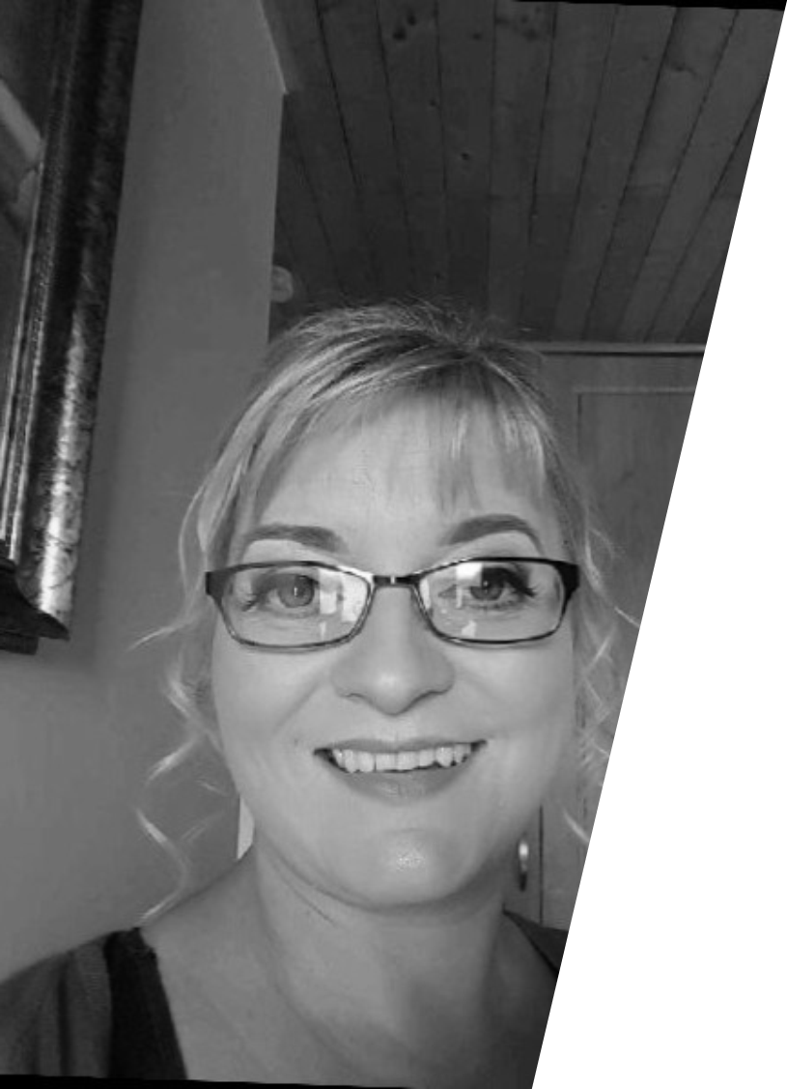
Mag Furness
Mag is a mother to two boys one of whom is neurodivergent. She is an experienced Board Of Director with a demonstrated history of working in the civic & social organisation industry. She is currently a Special Needs Assistant in a special class for autistic children in New Ross and has been in this post for over 5 years. She was one of the first cohort who completed the National Training Programme for Special Needs Assistant (Inclusive School Support) in UCD. She was Chairperson of Cottage Autism Network a family support group for autistic families in Co. Wexford. She is currently the Chairperson of the Rainbow Youth Club in New Ross which is specifically for children with additional needs. Mag has vast experience of volunteering for numerous charities having held the post of Social Media Officer/Website administrator for My Canine Companion -Autism and Therapy Services. Mag holds a BA in Business & Legal Studies from WIT.

Slide 4
WHAT IS THE DREAM BIG PROJECT?
Social Enterprise
To provide a supportive living program and build self contained
apartments/connect with housing bodies like Cluid, Respond
or Focus Ireland to become a partner in the project.
Transition programme and support students in their transition from school to college/workplace. Establish a Pilot programme for TY students with Kennedy College.
Provide training – Empowerment training for parents.
Provide employment for neurodiverse adults
Wrap around programme – from diagnosis to end of life.
Respite Centre
Pre-school
Booklet providing information from diagnosis through to supports available through adulthood.
Sibling workshops
Expanding youth club for younger age groups.

Slide 5
Our journey so far
Rainbow Youth Club - New Ross established in November 2021– Affiliated to the Ferns Diocesan Youth Service. A youth club for children with additional needs 10-16 years. Establishment of the junior youth club in May 2022. We have established a monthly group for children who are waiting a diagnosis or who have received a diagnosis from the age 2 to 5 years.
Networking with other disability organisations and individuals who are interested in helping with the project is ongoing.
We are in the process of establishing focus groups to gather information about what exactly is needed in the area..
Teresa and Mag have had numerous meeting with officials from New Ross Municipal District council and Wexford Local Development.
Rainbow Charity, Cork is an incredible autism service provider based in Cork they provide supports, have a community hub for children/young autistic children and their families promoting inclusivity, education and career opportunities leading to a fulfilled lifestyle and participation in all aspects of society. Their centre embraces the whole support system for the child, not only providing professional therapies and courses but also educating and training parents, carers and professionals to provide the best possible outcomes for children. Ms. Karen O’Mahony and the Rainbow Charity, Cork are partnering with the Dreambig Project and expanding the services they offer to the South East.

Slide 6
What is Neurodiversity?

Slide 7
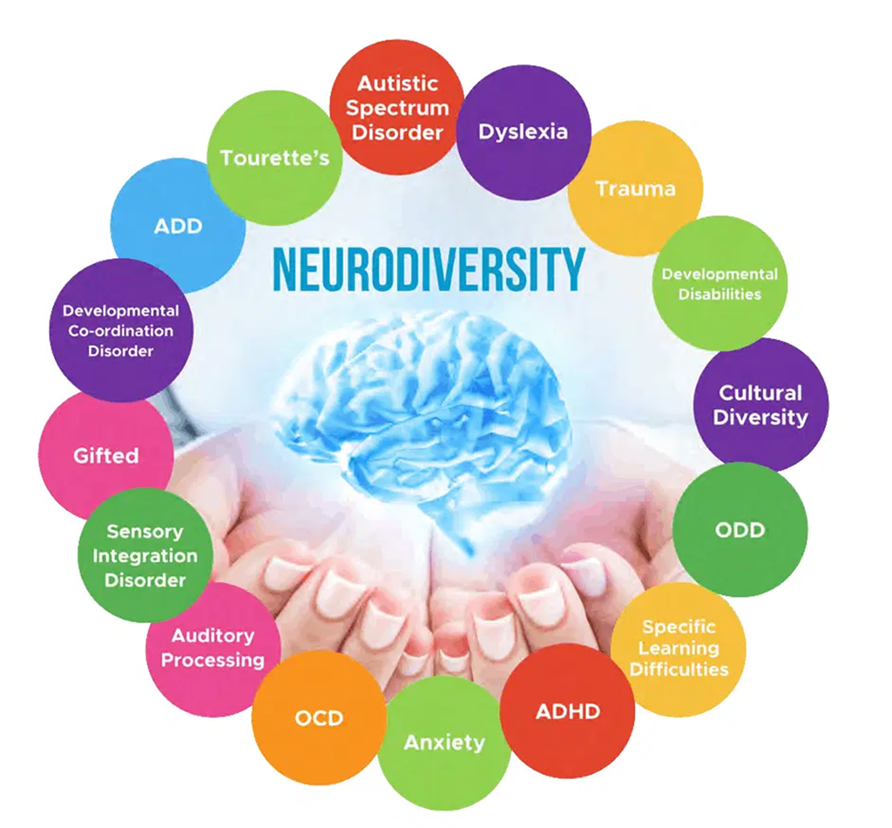
Neurodiversity - neurological differences between people should be recognised and respected. Instead of using terms like ’dys – function’ ‘dis- abilities’ & ‘dis-orders’ neurodiversity is an enabling term that takes into account neurological differences.
Neurodiversity – is not one size fits all.
We are all different and neurodiversity celebrates difference.
Neurodiversity is variations in the human brain in terms of sociability, learning, attention, mood and other cognitive functions. Neurodiversity considers that brain differences are normal rather than deficits.
Neurodivergent people experience interact with and interpret the world in unique ways.
This concept can help reduce stigma round learning and thinking differences.

Slide 8
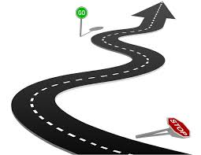
Our Plans
Dreambig
South East Project
Respite Centre/Independent Living
Training/Wrap around programme
Support to families
Social Enterprise
Supporting Individuals

Slide 9
Exciting News!!
A family who would like to remain anonymous at this time have been in contact with us and have informed us that they would like to develop a housing project similar to what the DREAMBIG project are also planning on an abandoned farm that they currently own. It would be a massive endeavour to complete without funding and support from the different government departments/ agencies. The redundant farmyard could be incorporated as a day centre. All very much an idea at this stage but they have visited similar projects in Ireland where funding did develop. Individuals with disabilities can get individual funding for housing and with the help of county councils and perhaps the HSE we could make this a home for young adults in our area.

Slide 10
Thank you
On behalf of the Dreambig South East board, we would like to take this opportunity to thank you for allowing us present today,
We welcome any questionsyou may have about the project.

