Slide 1

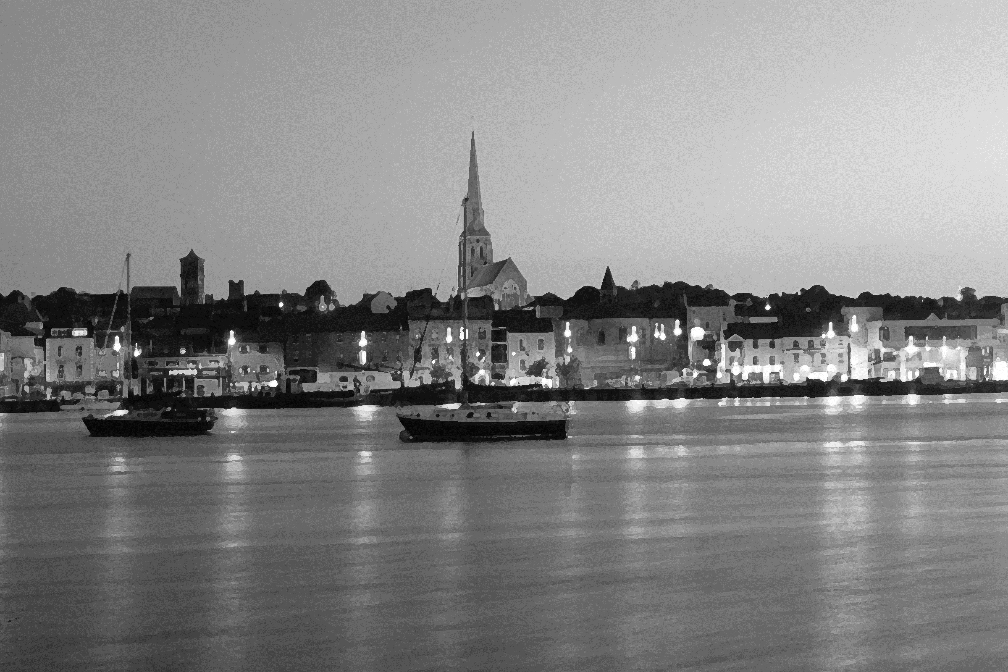

Wexford PPN Introduction

Slide 2
What is the PPN?
Under the Local Government Act 2014, PPNs were established as a way to build a network of community, social inclusion and environmental groups who work within a local authority area.
The main purpose of the PPN is to empower and assist groups to participate in local decision making.
Currently there are 31 PPNs across the country. Wexford PPN is currently hosted by Wexford County Council, with two full time staff assigned to work with the Secretariat for the day to day running of the PPN.

Slide 3
Main Objectives of Wexford PPN
Sharing information across members and to members. Information can vary from details of public consultations, training events, funding opportunities to member events.
Helping groups in achieving their objectives, by further developing themselves, through access to conferences, training, mentoring, networking, seminars etc .
Offering communities a seat and a voice at the decision-making tables within the county - allowing members to help in shaping important decision making.
Informing
Developing
Representing

Slide 4
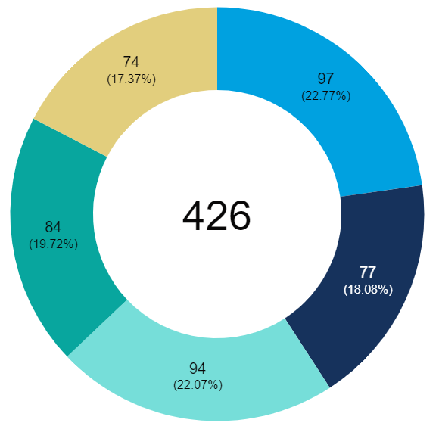
Our Member Groups
Currently, we have 426 registered member groups.
Gorey/Kilmukridge – 97
Rosslare – 77
Wexford – 94
New Ross - 84
Enniscorthy – 74
Pillars
Community - 346
Social Inclusion - 59
Environmental - 21

Slide 5
Our Representatives
The Secretariat
Municipal District Representatives
Enniscorthy – Bernard O’Leary
Gorey – Kevin Molloy
New Ross – Ann Lacey
Rosslare – Simon Boyse
Wexford – Patrick Rochford
Electoral Colleges Representatives
Social Inclusion – Thomas Cullen
Social Inclusion – Vacant
Community & Voluntary – Breda Cahill
Community & Voluntary – Linda Sinnott
Environmental – Kamal Tribak
Environmental – Vacant

Slide 6
Our Representatives
Local Development Community Committee (LCDC)
Brian Toomey
Aislinn Dunne
John Carr
Jonathan King
Sharon Kennedy
Karin Dubsky

Slide 7
Our Representatives
Strategic Policy Committees (SPCs)
Seamus Murphy - Economic Development & Enterprise
Senan O Reilly - Economic Development & Enterprise
William Considine - Housing & Community
Anne Sharry - Housing & Community
Allen Holman - Environment & Climate Change
Kevin Molloy- Environment & Climate Change
Danny Forde - Environment & Climate Change
John Waters - Transportation & Water Services
Tom Logan - Transportation & Water Services
Zeno Winkens - Planning & Building Control

Slide 8
Our Representatives
Council Committees
Tony Clyne - Joint Policing Committee (JPC)
Dan Kennedy - Joint Policing Committee (JPC)
Caoimhe Dunn - County Heritage Forum
Peter O Connor - County Heritage Forum
Bernard O’Leary - Enniscorthy Town Centre First

Slide 9
Our Representatives
Non-Council Committees
Mark Rodgers - Sports Active – Wexford Local Sports Partnership
Maria Gore - Sports Active – Wexford Local Sports Partnership
Ann Lacey - Southeast Regional Drugs & Alcohol Taskforce (SERDATF)
Breda Flood - Wexford Healthy County Committee
Ian Ludlow (Resource Officer) - Wexford Comhairle na nÓg Steering Committee
Ian Ludlow (Resource Officer) - Wexford County Council Climate Action Steering Group

Slide 10
2022 Expenditure Summary
Salary Resource Worker incl. PRSI | €54,216.11
Resource Worker Travel & Subsistence | €1,644.78
Secretariat Travel & Subsistence paid for by PPN | €3,460.48
PPN Representatives Travel & Subsistence paid for by PPN | €462.24
Postage / Telephone | €1,693.20
Online Communication tools (e.g online meeting software, survey software) | €643.43
Office Supplies/Stationery/Printing | €903.00
Light and Heat | €550.00
Equipment for PPN | €1,200.00
Membership of external orgs/ workshops & conferences attended by PPN | €200.00
Projects/Activities /Events sponsored by PPN | €8,202.38
IT/Server Support & Maintenance | €2,643.36
Marketing and Promotion of PPN | €3,442.52
Plenary/Meeting Costs (including Room Hire /Refreshments) | €4,064.22
General Maintenance – cleaning, waste etc. | €635.44
Salary Support Worker Inc PRSI | €30,230.51
Support Worker Travel and Subsistence | €366.14
Support Worker Associated Costs | €644.59
Total Expenditure | €115,202.40

Slide 11
PPN Workers Manifesto (A Snippet)
April 2023
Let’s make this world one of compassion and empathy.
Let’s pass on love and passion to the next generation.
Let’s be the kindness we want to see in the world.
Let’s be aware that we all have a contribution to make;
That the smallest interaction,
Can make the biggest change.

Slide 12
Thank You
We hope you
enjoy the event

