Slide 1
Wexford Pride PPN Presentation 2023

Slide 2
OUR COMMITTEE
JOHN CUNNINGHAM-RYAN
RÍAN BROWNE
VIC KELLY-VICTOR
VERONICA VICTOR
SECRETARY
PUBLIC RELATIONS OFFICER
TREASURER
COMMUNITY LIAISON

Slide 3
2022 PRIDE IN THE PARK

Slide 4
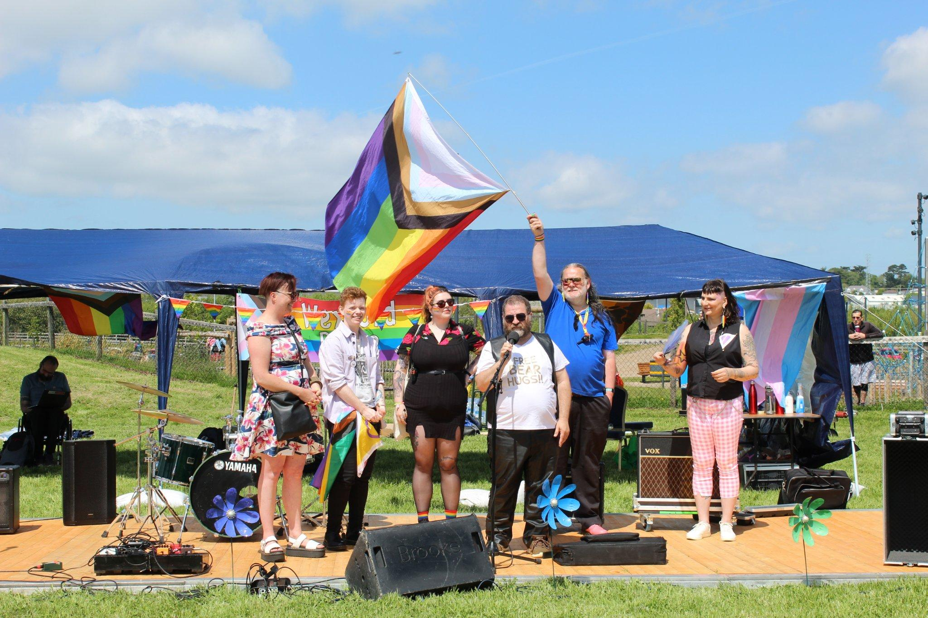
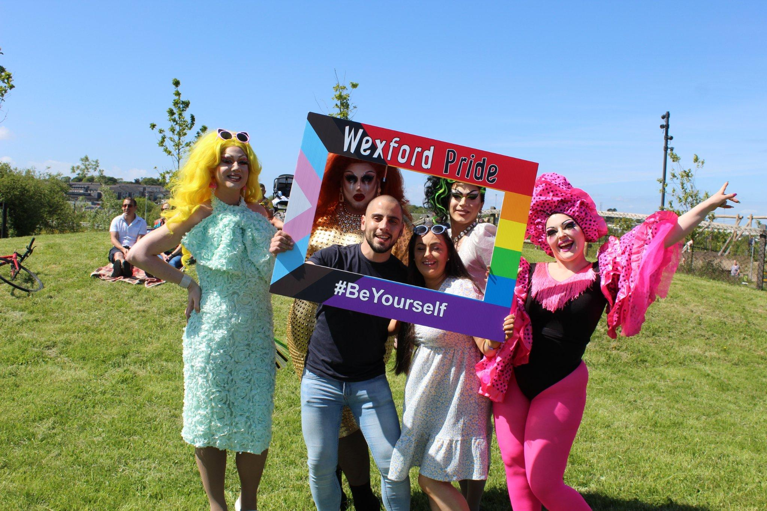
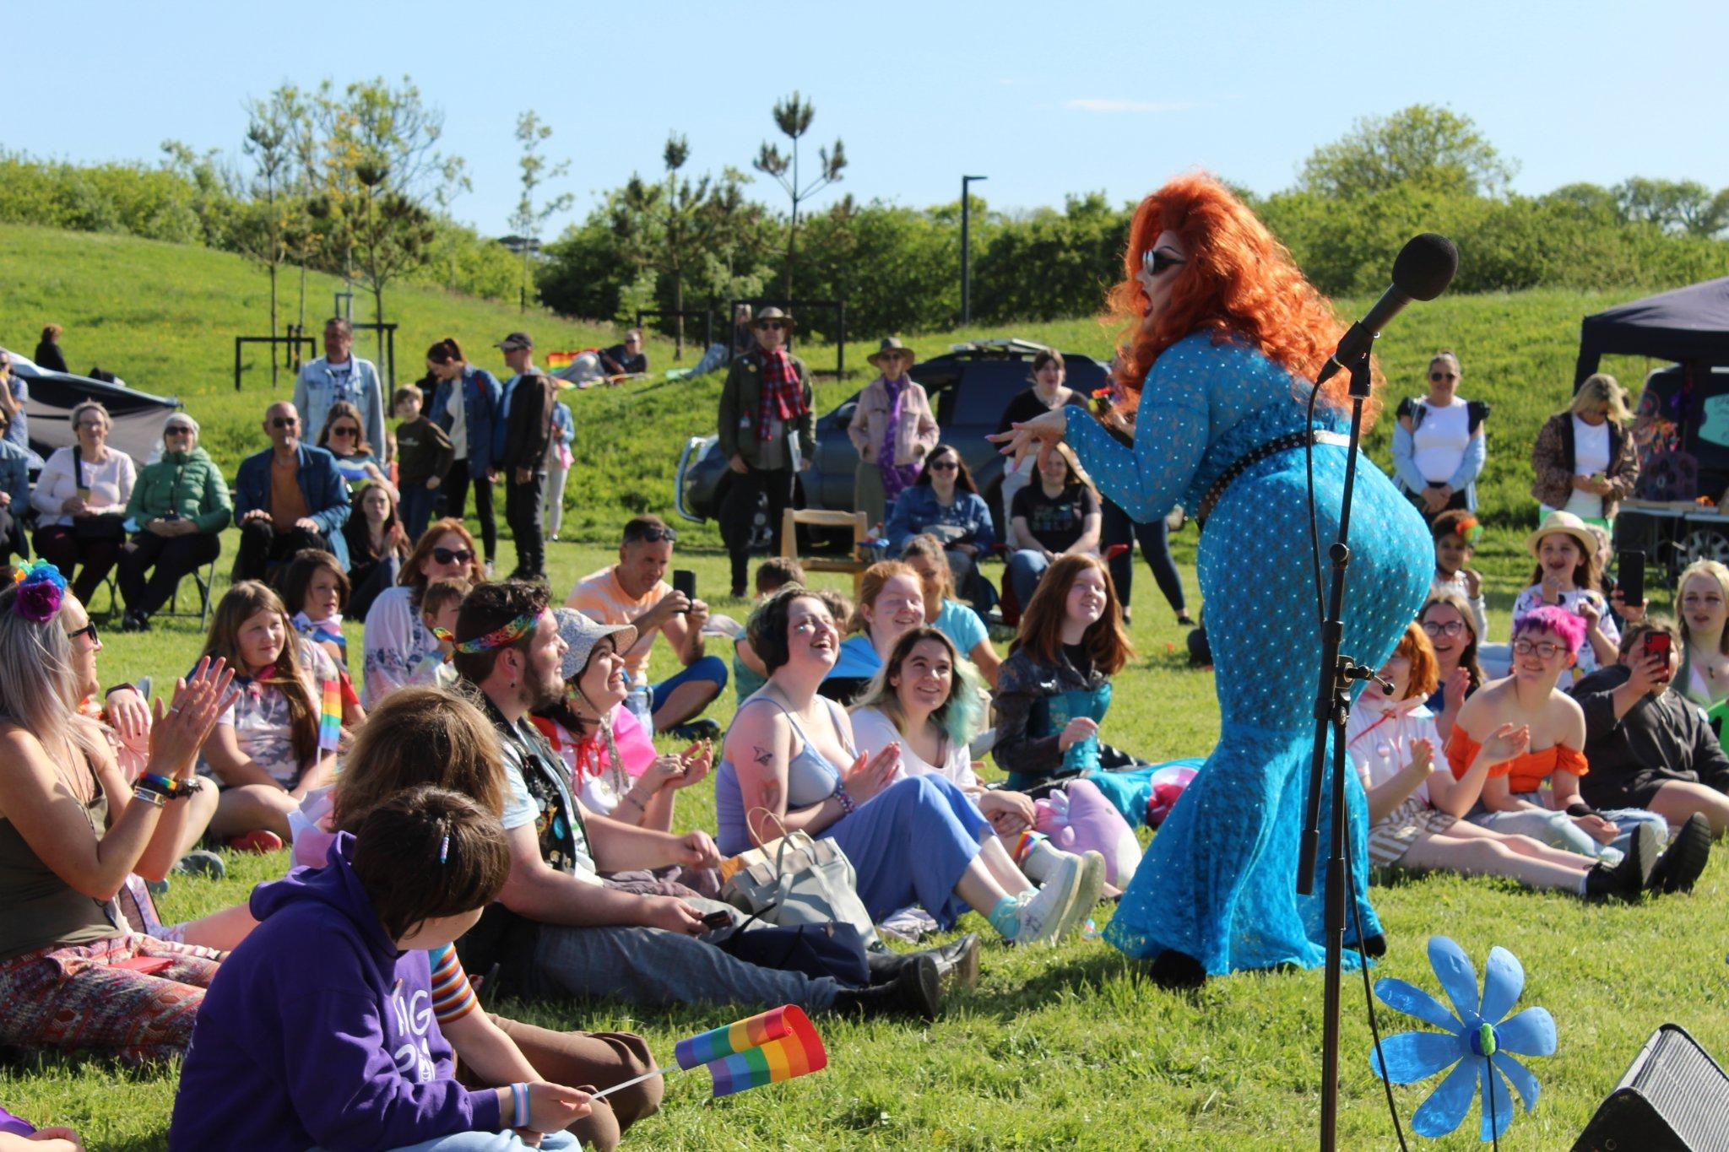
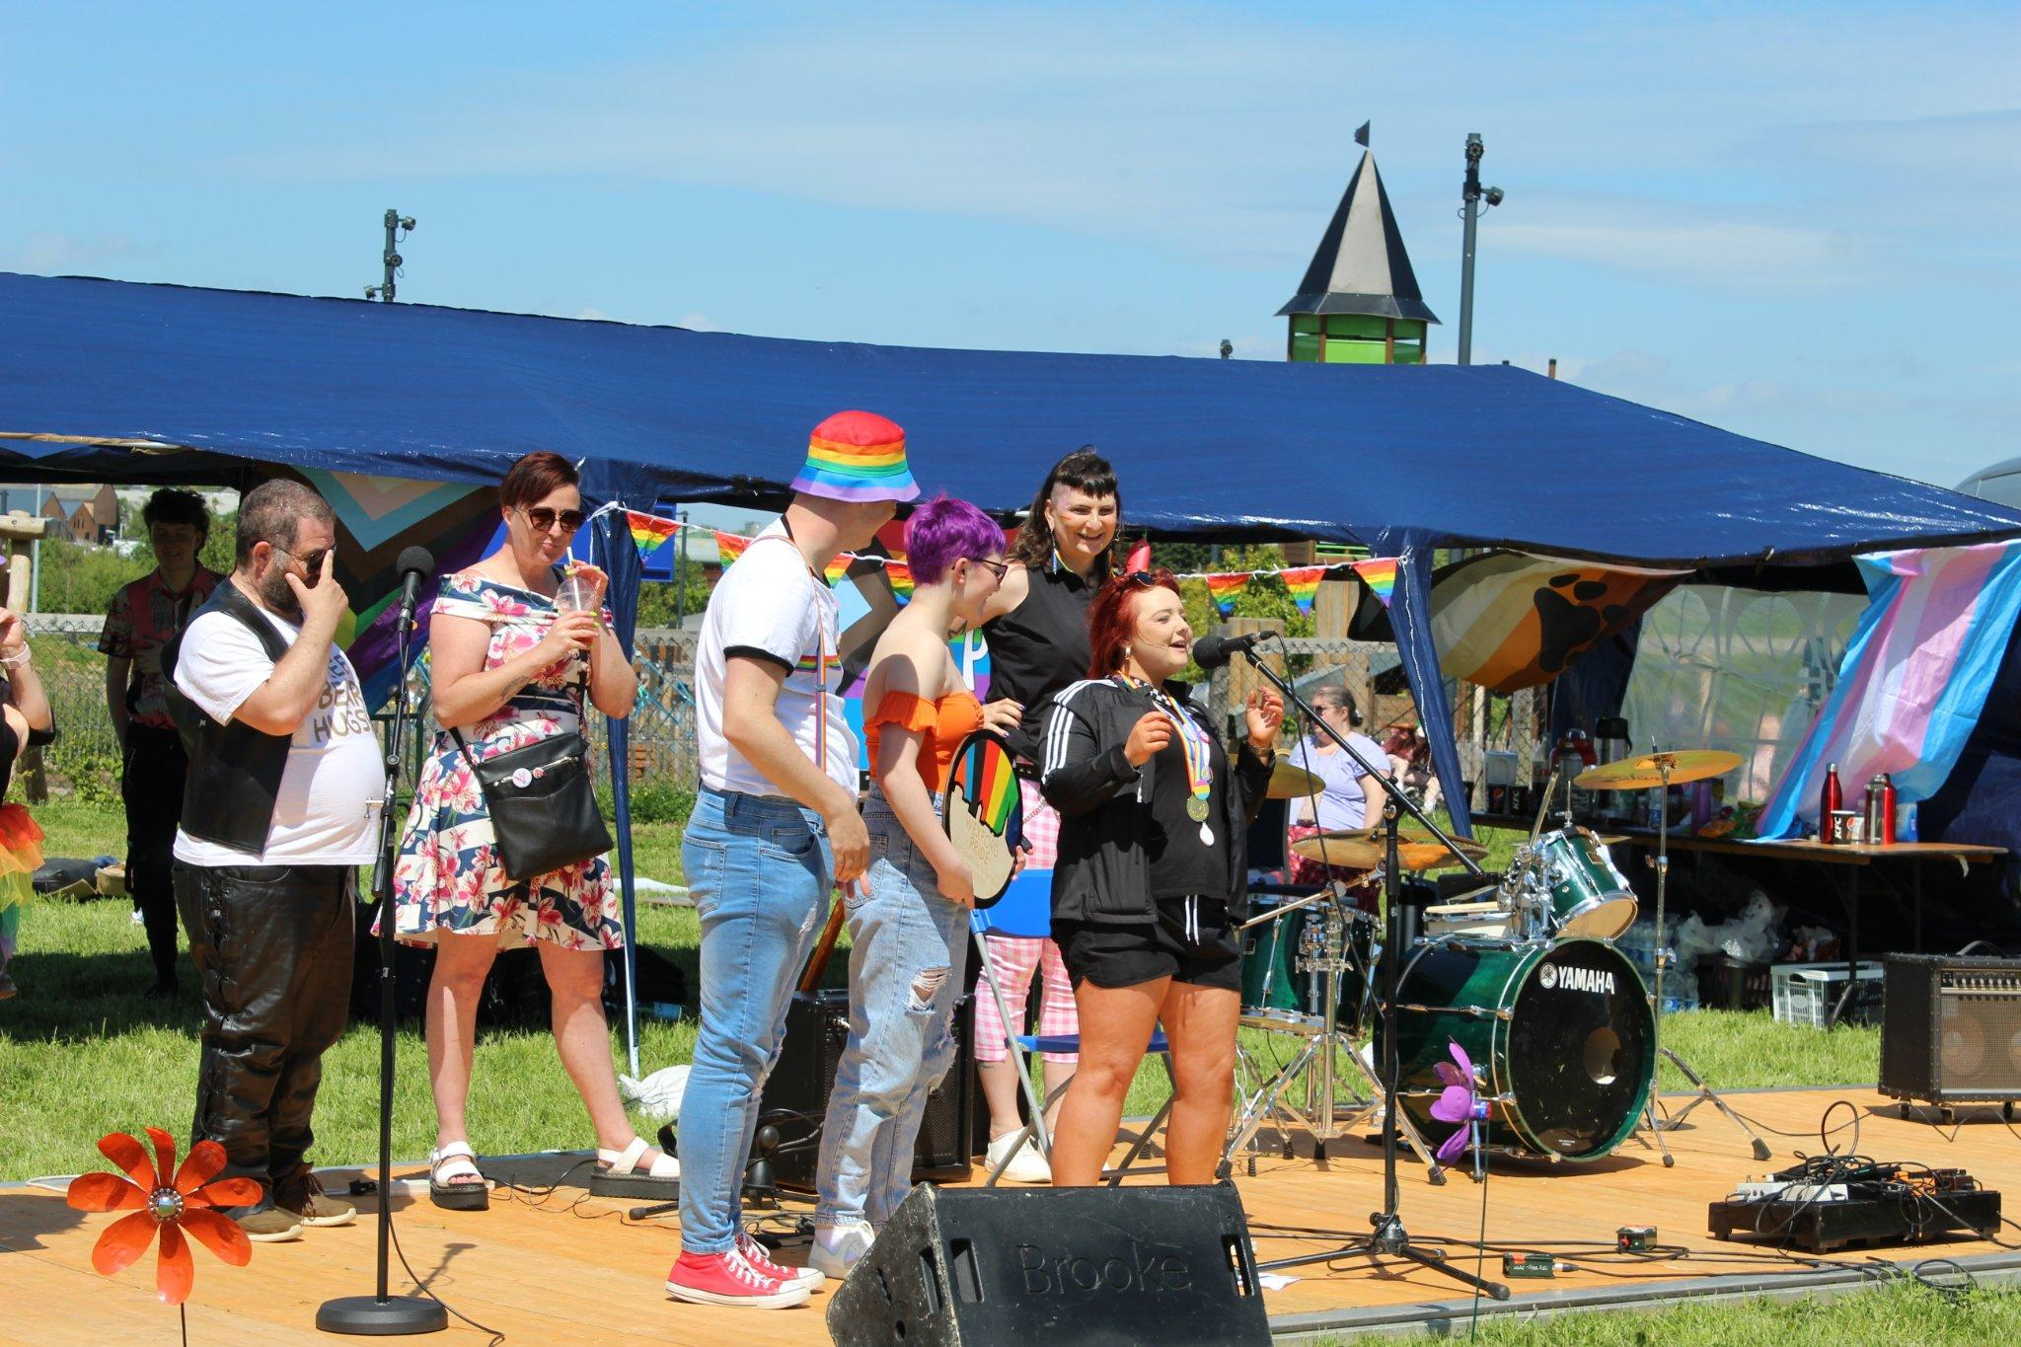
PRIDE IN THE PARK 2022
Wexford’s largest pride celebration to date! (200+ attendees)
€2,000+ raised
Raffle sponsorship from 14 businesses
10 vendors & community groups
FDYS Orbit & Solidarity LGBT+ Group Music & Spoken Word Performances
Live music from Peer Pleasure, For. The. Company, Vistafutur
Stand Up from Vic Kelly-Victor
Mockie Ah! Drag performance & afterparty

Slide 5
PRIDE IN THE PARK 2022
“I've been out since 2016 and it brings me a lot of joy to see younger members of our community band together and build something truly admirable. I was one of the few students in my year in secondary school, so to see how quickly things have changed is really uplifting.”
“The event in Min Ryan Park was the first time in so long that I felt completely safe and most like my authentic self.I've been riding that wave of optimism, hope and queer joy ever since.”
“I don't feel like Wexford is a place where I can be truly myself. It was wonderful to have a space where I could let my guard down and be me. I can only imagine what this expereince is like for queer youth who are discovering who they are in our town.“

Slide 6
2023 PRIDE IN THE PARK

Slide 7
THE REST OF THE YEAR

Slide 8
REGULAR EVENTS
TEA ON THE QUAY
LGBTQIA+ SUPPORT GROUP

Slide 9
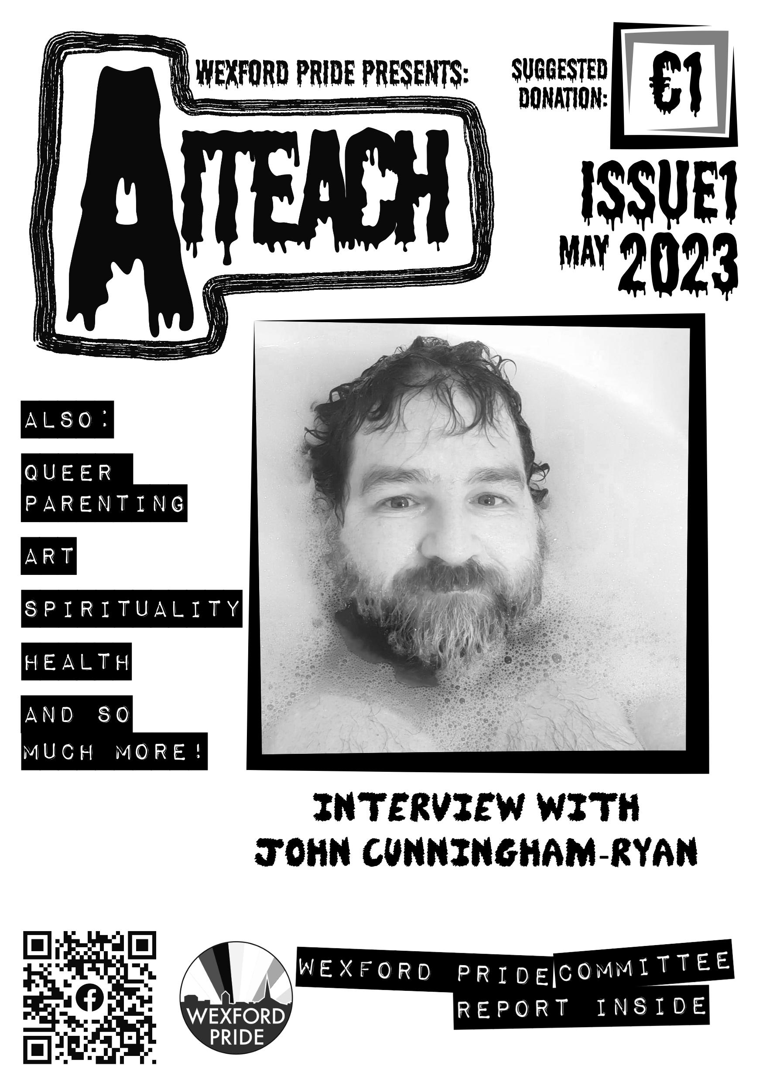
REGULAR EVENTS
MONTHLY BOOKCLUB
AITEACH ZINE AND NEWSLETTER

Slide 10
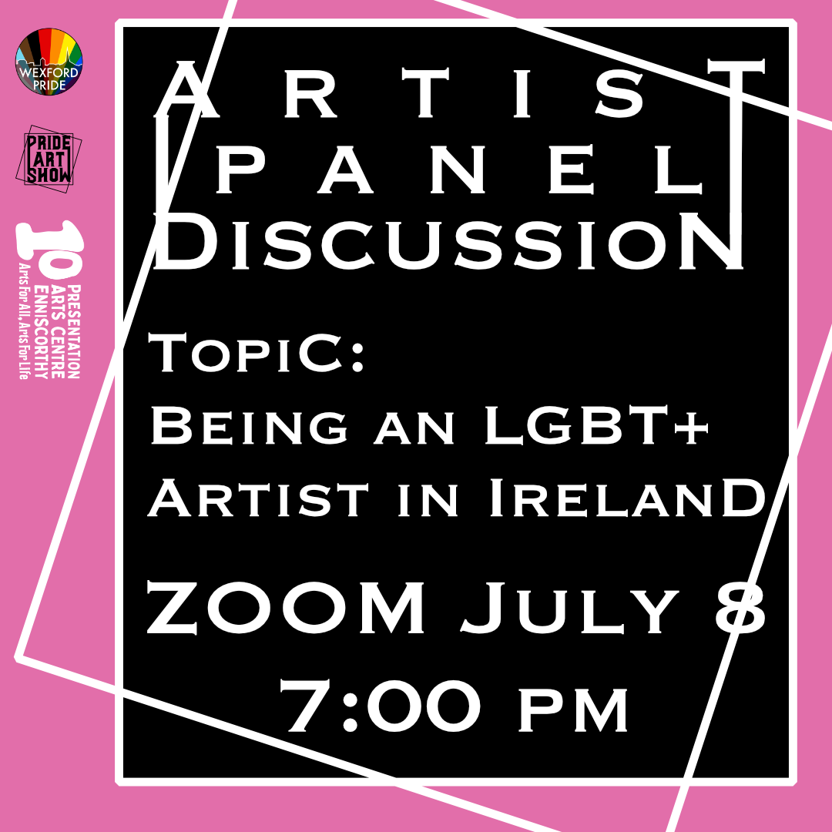
PRIDE ART SHOW AND ARTIST PANEL

Slide 11
MELON BALL CONCERT AND PROTEST

Slide 12
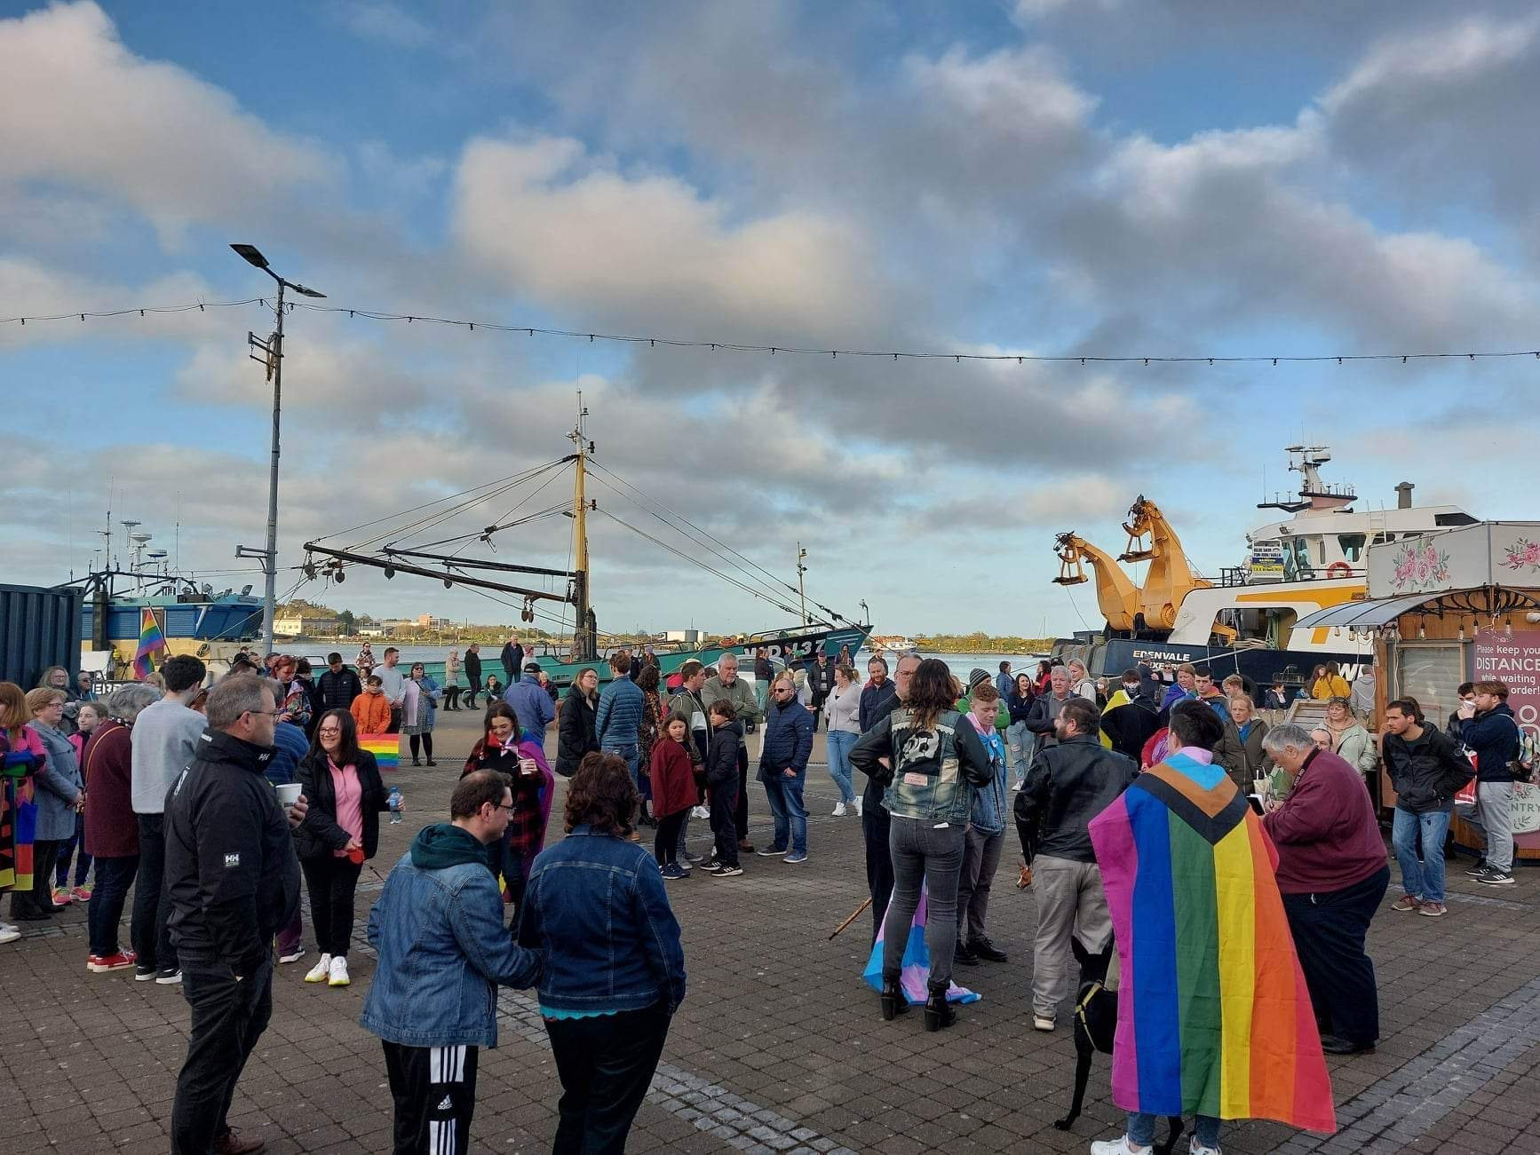
MICHAEL SNEE AND AIDAN MOFFITT VIGIL

Slide 13
HALLOWEEN DANCE PARTY AND TABLE QUIZ

Slide 14
CHRISTMAS MARKET

Slide 15
HOW ARE WE FUNDED?

Slide 16
100% VOLUNTEER-RUN
DONATIONS
PERSONAL
COMMERCIAL
DISCRETIONARY FUNDS
SOME SCHEMES

Slide 17
Public Relations Officer
Rían Browne

Slide 18
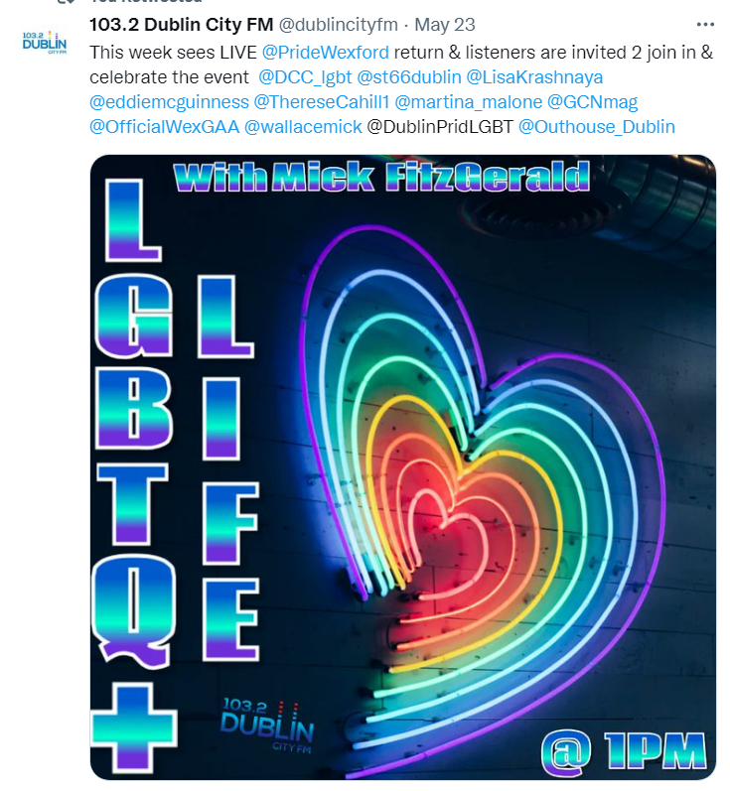
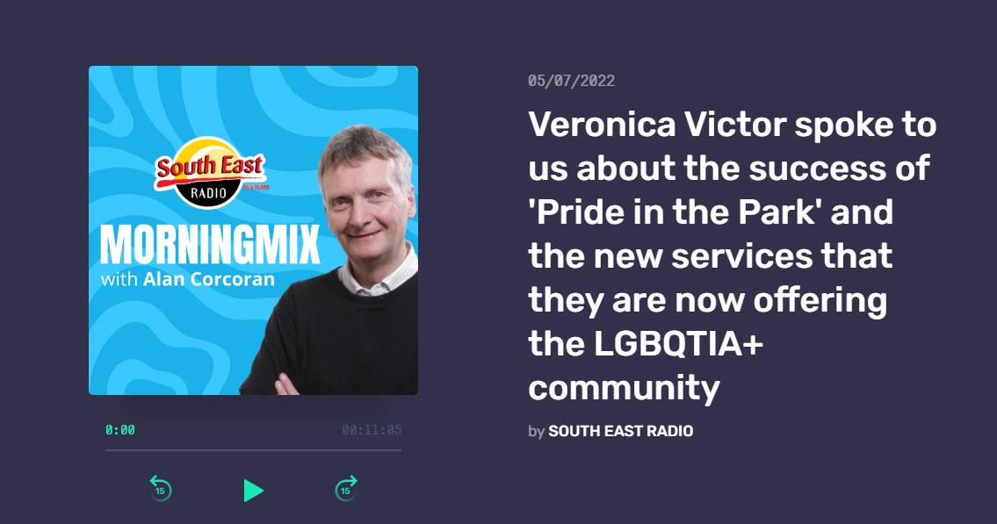
PRO
In The Media
Dublin LGBT Life Podcast, The Independent, GCN, South East Radio, Wexford People

Slide 19
PRO
Building People Power! Beyond the likes…
Social media as a tool to build community and spread the word of events, call-outs and news beyond traditional media.
Allows us to connect with other organizations across the country collaborations with Neuropride Ireland, Irish Traveller Movement, Pride Map
ONLINE
Facebook & Instagram
Combined following - 3,000
Combined reach - 8,300
Cultivation of positive and safe LGBQTIA+ online spaces - wexfordpride.wordpress.com

Slide 20
THANKS!
Does anyone have any questions?
wexfordpride@gmail.com
087-395-3846

